Slide 1
CSC 112: Computer Operating Systems Lecture 3 Scheduling
Department of Computer Science,
Hofstra University
Acknowledgement: Lecture slides based on UC Berkeley CS 162: Operating Systems and System Programming

Slide 2
Overview
Metrics to evaluate scheduling algorithms
Goals of Scheduling algorithms
Different scheduling algorithms,
First in first out (FIFO)
Shortest job first (SFJ)
Shortest time-to-complete first (SCTF)
Round-robin (RR)

Slide 3
Scheduling
Scheduling is an important problem in many contexts, e.g., logistics, airports, game schedule, etc.
OS Scheduling: policies that OS employs to determine the execution order of ready processes
Scheduling algorithms/schedulers have diverse objectives and demonstrate different effects on the system performance

Slide 4
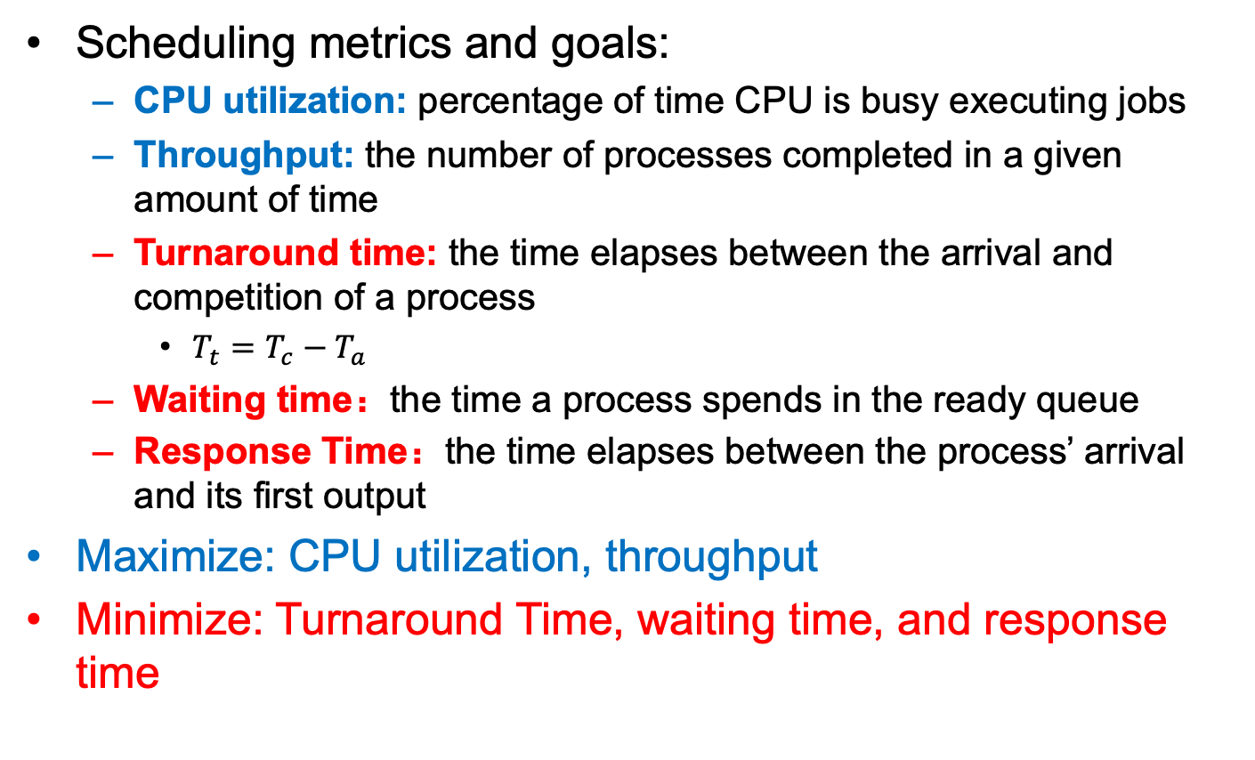
Terminologies
Scheduling metrics and goals:
CPU utilization: percentage of time CPU is busy executing jobs
Throughput: the number of processes completed in a given amount of time
Turnaround time: the time elapses between the arrival and competition of a process
$T_{t}=T_{c}−T_{a}$
Waiting time：the time a process spends in the ready queue
Response Time：the time elapses between the process’ arrival and its first output
Maximize: CPU utilization, throughput
Minimize: Turnaround Time, waiting time, and response time

Slide 5
Workload Assumptions
Each job runs for the same amount of time
All jobs arrive at the same time
All jobs only use the CPU (no I/O)
Run-time of each job is known
Once started, each job runs to completion (non-preemption)

Slide 6
First In First Out (FIFO)
A simple and basic scheduling algorithm, also called First Come First Served (FCFS)
Jobs are executed in arrival time order
A first, B slightly later, and then C
Job | Arrival time (ms) | Run time (ms)
A | 0 | 10
B | 0 | 10
C | 0 | 10
Gantt Chart
A
B
C
0
10
20
30
Time

Slide 7

First In First Out (FIFO)
$T_{t}=T_{c}−T_{a}$
A: 10-0 = 10
B: 20-0 = 20
C: 30-0 = 30
Average turnaround time = (10 + 20 + 30) / 3 = 20
Job | Arrival time (ms) | Run time (ms) | Finishing time (ms)
A | 0 | 10 | 10
B | 0⁺ | 10 | 20
C | 0⁺⁺ | 10 | 30

Slide 8
First In First Out (FIFO)
Average turnaround time = (70 + 80 + 90) / 3 = 80
Each job runs for the same amount of time
Job | Arrival time (ms) | Run time (ms) | Finishing time (ms)
A | 0 | 10 -> 70 | 70
B | 0⁺ | 10 | 80
C | 0⁺⁺ | 10 | 90
Gantt Chart
A
B
C
0
70
80
90
Time

Slide 9



First In First Out (FIFO)
Convoy effect
A number of jobs queued up behind one long job to finish execution, causing overall device and CPU utilization to be suboptimal.
Long job
Short job
Short job

Slide 10
Shortest Job First (SJF)
How to minimize average turnaround time? Run short jobs before long ones.
SJF: jobs with the shortest execution time is scheduled first
Analogy: at supermarket checkout, Let people with few items jump the queue to cut in front of people with many items. It is not fair for each person, but more efficient from the supermarket (OS) perspective
Average Turnaround time = (10 + 20 + 90) / 3 = 40 (vs. 80 for FIFO)
Job | Arrival time (ms) | Run time (ms) | Finishing time (ms)
A | 0 | 70 | 90
B | 0 | 10 | 10
C | 0 | 10 | 20
 | Average Turnaround | Average Turnaround | 40
B
C
A
0
10
20
90
Time

Slide 11
Shortest Job First (SJF)
SJF is an optimal scheduling algorithm in terms of average waiting time given these assumptions:
All jobs arrive at the same time
All jobs only use the CPU (no I/O)
Run-time of each job is known
Once started, each job runs to completion (non-preemption)

Slide 12
Shortest Job First (SJF)
SJF is no longer optimal if not all jobs arrive at the same time:
All jobs arrive at the same time
Job | Arrival time (ms) | Run time (ms) | Finishing time (ms)
A | 0 | 70 | 70
B | 10 | 10 | 80
C | 20 | 10 | 90
 | Average Turnaround | Average Turnaround | (70+70+70)/3 = 70
A
B
C
0
70
80
90
Time
B and C are ready here, but cannot be scheduled due to non-preemption
Notes:
Moving a short process before a long one decreases the waiting time of the short process more than it increases the waiting time of the long process.
All jobs only use the CPU (no I/O)
Run-time of each job is known
Once started, each job runs to completion (non-preemption)

Slide 13
Shortest Time-to-Complete First (STCF)
Once started, each job runs to completion
This assumption indicates the concept of non-preemption
FIFO and SJF are both non-preemptive schedulers
STCF policy: Always switch to jobs with the shortest completion time
STCF is a preemptive scheduler
STFC is optimal in terms of minimizing the average waiting time, if the assumptions hold.

Slide 14
Shortest Time-to-Complete First (STCF)
STCF may cause starvation
How about other metric?
Job | Arrival time (ms) | Run time (ms) | Finishing time (ms)
A | 0 | 70 | 90
B | 10 | 10 | 20
C | 20 | 10 | 30
 | Average Turnaround | Average Turnaround | (90+20+30)/3 = 46.7 (70)
A
B
C
A
0
30
90
Time
10
20

Slide 15
Response Time
Response time refers to the time between a process's arrival in the ready queue and its first execution on the CPU. This metric is crucial for evaluating the responsiveness of the system, especially for interactive applications
FIFO
R = (0 + 30 + 50) / 3 = 26.7
SJF
R = (0 + 10 + 30) / 3 = 13.3
A better scheduler for response time? Round-Robin (RR)
Job | Arrival time (ms) | Run time (ms)
A | 0 | 30
B | 0⁺ | 20
C | 0⁺⁺ | 10

Slide 16
Round-Robin (RR)
Concept of time quantum/time slice/scheduling quantum: a fixed and small amount of time units
Each process executes for a time slice
Switches to another one regardless whether it has completed its execution or not
If the job has not yet completed its execution, the incomplete job is added to the tail of the ready queue, FIFO queue.
Notes:
Alternate ready processes every fixed-length time-slice, you have a circular queue

Slide 17
Round-Robin (RR)
Assume that time slice is 5
Job | Arrival time (ms) | Run time (ms)
A | 0 | 30
B | 0⁺ | 20
C | 0⁺⁺ | 10
A
B
C
A
B
C
A
B
A
B
A
A
0
60
Time
R = (0 + 5 + 10) / 3 = 5
Notes:
Alternate ready processes every fixed-length time-slice, you have a circular queue

Slide 18
Round-Robin (RR)
Job | Arrival time (ms) | Run time (ms) | Time quantum
A | 0 | 5 | 1
B | 0 | 5
C | 0 | 5
RR
R = (0 + 1 + 2) / 3 = 1
RR is a good scheduler in terms of short response time
But poor in terms of turnaround time
FIFO: T = (5 + 10 + 15) / 3 = 10
SJF: T = (5 + 10 + 15) / 3 = 10 (same as FIFO since each job has the same run-time)
RR: T = (13 + 14 + 15) / 3 = 14

Slide 19
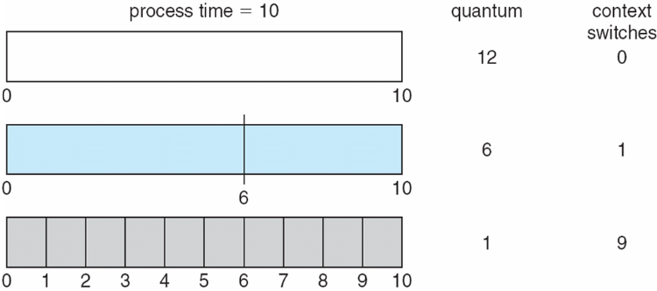
Round-Robin (RR)
If there are n processes in the ready queue and the time quantum is q, no process waits more than (n-1)q time units
The selection of time quantum size should be carefully considered (usually 10-100 milliseconds)
Switching between processes incurs some overhead, i.e., context-switch time
Turnaround time depends on the size of time quantum
Notes:
Use a timer to implement this

Slide 20
Round-Robin (RR)
RR is a starvation-free scheduler
STCF may cause starvation: some processes may never get scheduled, e.g., processes with long execution times
RR is fair, simple, and easy to implement and thus is used in modern OSs, such as Linux, Windows, and MacOS.
Notes:
when they shut down the IBM 7094 at MIT in 1973, they found a low-priority process that had been submitted in 1967 and had not yet been run.

Slide 21
Summary
There are different metrics to evaluate the performance of scheduling algorithms.
FIFO is a simple scheduler, but suffers from the convoy effect
SJF is an optimal scheduling algorithm in terms of minimizing average waiting time, if all jobs start simultaneously and know their execution times in prior
STCF is an optimal scheduling algorithm in terms of minimizing average turnaround time, if all jobs know their execution times in prior
RR is a better algorithm in terms of minimizing average response time

Slide 22
Incorporating I/O
All jobs only use the CPU (no I/O)
Every program uses I/O
Process execution consists of
CPU execution (CPU burst)
I/O wait (I/O burst)
CPU
A
A
A
B
I/O
A
A
Notes:
CPU burst
I/O burst
process execution consists of a cycle of CPU execution and I/O wait

Slide 23
Incorporating I/O
Treating each CPU burst as a sub-job
Schedule a CPU burst
Initialize the subsequent I/O burst, when the CPU burst completes
Switch to another process
A
A
A
B
CPU
A
B
A
B
A
B
CPU
Overlap
A
A
I/O
A
A
I/O
Run-time of each job is known

Slide 24
Priority-Based Scheduling
Run-time of each job is known
A priority level (integer) is assigned to each process
Larger number indicates higher priority (typically)
FIFO, SJF, STCF are special priority-based scheduling algorithms
The process with the highest priority is always scheduled
Priority-Based Scheduling:
Preemptive or non-preemptive
Different priority assignment methods
Internal or external
Priority-based scheduling may suffer from starvation (solution: aging)
Notes:
Internal: timing constraints, memory requirements, the ratio of average I/O burst to average CPU burst
External: Importance of the process, financial considerations, hierarchy among users

Slide 25
Multi-Level Feedback Queue (MLFQ)
SJF and STCF are good for turnaround time, but poor for response time
In contrast, RR are good for response time, but terrible for turnaround time
We need a scheduling algorithm that
Optimizes turnaround time for batch programs
Minimizes response time for interactive programs
Multi-level Feedback Queue (MLFQ) combines
Priority-based scheduling
RR

Slide 26
Multi-Level Feedback Queue (MLFQ)
MLFQ maintains a number of queues (multi-level queue)
Each queue has a different priority level
Jobs which are on the same queue have same priority
Jobs are assigned to a queue
High priority
A
B
Rule 1: If priority(A) > Priority(B), A runs
A&B are scheduled before C
Rule 2: If priority(A) == Priority(B), A & B run with RR
C
Low priority

Slide 27
Multi-Level Feedback Queue (MLFQ)
MLFQ varies the priority of a job instead of having a fixed priority
MLFQ varies the priority of a job based on its observed behavior
Rule 3: When a job enters the system, it is placed at the highest priority
Rule 4a: If a job uses up an entire time slice while running, its priority is reduced (i.e., it moves down on queue).
Rule 4b: If a job gives up the CPU before the time slice is up, it stays at the same priority level

Slide 28
Multi-Level Feedback Queue (MLFQ)
Rule 3 and 4a (starts at the highest, and lower if not finished)
A long running job; Time slice is 10ms
High priority
Q2
Lower priority
Q1
Low priority
Q0
0
50
100
150
200
Time (ms)

Slide 29
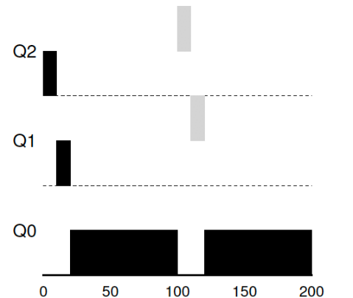
Multi-Level Feedback Queue (MLFQ)
Job A: A long-running CPU-intensive job
Job B: A short-running interactive job (20ms runtime), arrives at 100ms
A
B
High priority
Lower priority
Preemption
Low priority
Time (ms)

Slide 30
Multi-Level Feedback Queue (MLFQ)
Rule 4b (stays at the same priority);
Job A: A long-running CPU-intensive job
Job B: An interactive job that only needs CPU for 5ms before I/O
B
Remain at the same priority
A
High priority
Q2
Lower priority
Q1
Q0
Low priority
Time (ms)
Notes:
Take I/O into account

Slide 31
Multi-Level Feedback Queue (MLFQ)
What are the problems of the current MLFQ?
Starvation
Processes may “game the scheduler” to get more resource share
Changed behavior over time
A
B
Remain at the same priority
High priority
Q2
Q1
Lower priority
Low priority
Q0

Slide 32
Multi-Level Feedback Queue (MLFQ)
Starvation
B
Interactive jobs always occupy the CPU
C
A
High priority
Q2
Lower priority
Q1
Long-running job starves
Q0
Low priority

Slide 33
Multi-Level Feedback Queue (MLFQ)
Rule 5: After some time period S, move all the jobs in the system to the topmost queue.
B
Lower priority
C
A
High priority
Q2
Helpful for changed behavior
Q1
Q0
Low priority
Priority boost

Slide 34
Multi-Level Feedback Queue (MLFQ)
Rule 4a: If a job uses up an entire time slice while running, its priority is reduced (i.e., it moves down on queue).
Rule 4b: If a job gives up the CPU before the time slice is up, it stays at the same priority level
Rule 4: Once a job uses up its time allotment at a given level (regardless of how many times it has given up the CPU), its priority is reduced(i.e., it moves down one queue).

Slide 35
Multi-Level Feedback Queue (MLFQ)
B
A
High priority
Q2
Used up its time allotment
Lower priority
Q1
Q0
Low priority

Slide 36
Multi-Level Feedback Queue (MLFQ)
The refined set of MLFQ rules:
Rule 1: If Priority(A) > Priority(B), A runs (B doesn’t).
Rule 2: If Priority(A) = Priority(B), A & B run in RR.
Rule 3: When a job enters the system, it is placed at the highest priority.
Rule 4: Once a job uses up its time allotment at a given level (regardless of how many times it has given up the CPU), its priority is reduced(i.e., it moves down on queue).
Rule 5: After some time period S, move all the jobs in the system to the topmost queue.
Benefit of MLFQ
It does not require prior knowledge on the CPU usage of a process.

Slide 37
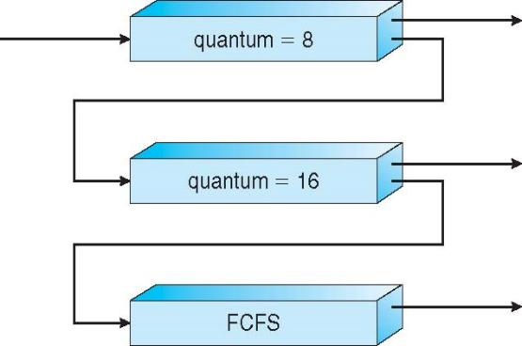
Multi-Level Feedback Queue (MLFQ)
MLFQ scheduler is defined by the following parameters
Number of queues
Time quantum of each queue
How often should priority be boosted?
Scheduling algorithms for each queue
etc.
High priority queue:
Interactive processes
Response time
Low priority queue:
Batch processes (CPU-intensive)
Turnaround time

Slide 38
Proportional Share Scheduling
Fair-share scheduler
Guarantee that each job obtain a certain percentage of CPU time.
Not optimized for turnaround or response time
Lottery scheduling
Based on the concept of tickets
The percentage of tickets denotes the share of a resource for a process
There are two processes, A and B.
Process A has 75 tickets → receive 75% of the CPU
Process B has 25 tickets → receive 25% of the CPU

Slide 39
Proportional Share Scheduling
A probabilistic way to implement lottery scheduling
Time slice (like in RR)
Scheduler knows how many tickets exist
Scheduler picks a winning tickets from the ticket pool for each time slice
Example
There are 100 tickets
Process A has 75 tickets: 0 ~ 74
Process B has 25 tickets: 75 ~ 99
Scheduler’s winning tickets:
63 85 70 39 76 17 29 41 36 39 10 99 68 83 63
Resulting scheduler:
A
B
A
A
B
A
A
A
A
A
A
B
A
B
A
A ≈ 74%
B ≈ 26%
Notes:
The longer these two jobs compete,
The more likely they are to achieve the desired percentages.

Slide 40
Completely Fair Scheduling (CFS)
Completely Fair Scheduling (CFS)
Choose the process with lowest execution time: vruntime.
Run the process for a time slice.
The current CPU scheduler in Linux (since 2.6.23, 2007)
Non-fixed time slice.
CFS assigns process`s time slice a proportion of the processor.
Priority
Enables control over priority by using nice value.
Efficient data structure.
Use red-black tree for efficient search, insertion and deletion of a process.
Notes:
Current linux kernel 6.1.1
17,900 lines of code

Slide 41
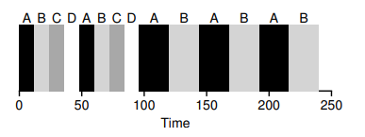
Completely Fair Scheduling (CFS)
Virtual runtime (vruntime)
Denotes how long the process has been executing.
Per-process variable
Increases in proportion with physical (real) time when it runs.
CFS will pick the process with the lowest vruntime to run next.
sched_latency
Used to determine how long a process should run before considering a switch.
A typical value is 48 (milliseconds)
process`s time slice = sched_latency / (the number of process)
N = 4, time slice = 12msec
N = 2, time slice = 24 msec
What if N = infinite, set the
minimum time slice value to 6 ms.

Slide 42
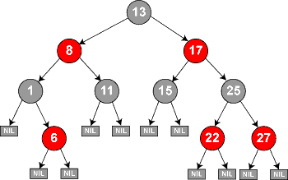
Completely Fair Scheduling (CFS)
CFS deploys a red-black tree
Balanced binary search tree
Ordered by vruntime as key
Complexity:
insertion, deletion, update -> O(logN)
find min -> O(1)

Slide 43
Completely Fair Scheduling (CFS)
How does CFS deal with I/O and sleep
When a process issues an I/O, it turns into sleep state. Then it will not accumulate vruntime
As soon as the long-sleep process is waked up, it has a small vruntime, i.e., a high priority. As a result, it is likely to monopolize CPU for a long while.
Solution: Set the vruntime of a wake-up process to the minimum value found in the RB-tree
How CFS boosts interactivity:
I/O-bound (Interactive) processes typically have shorter CPU bursts and thus will have a low vruntime – higher priority

